Slide 1
Internship With MLSA in Full Stack Web Development
By- Shivang verma
Roll No: 2200290100153
Branch: CSE
Year: 3rd

Slide 2
Introduction to Internship
During my online internship with MLSA, I focused on Full Stack Web Development.
This presentation will provide an overview of my key projects, including a To-Do List application and a Calculator website.

Slide 3
Overview of Full Stack Development
Full Stack Development involves both frontend and backend technologies.
I gained hands-on experience in HTML, CSS, and JavaScript for the frontend, while exploring Node.js and Express for backend development.
This comprehensive approach allowed me to understand the entire web development process

Slide 4
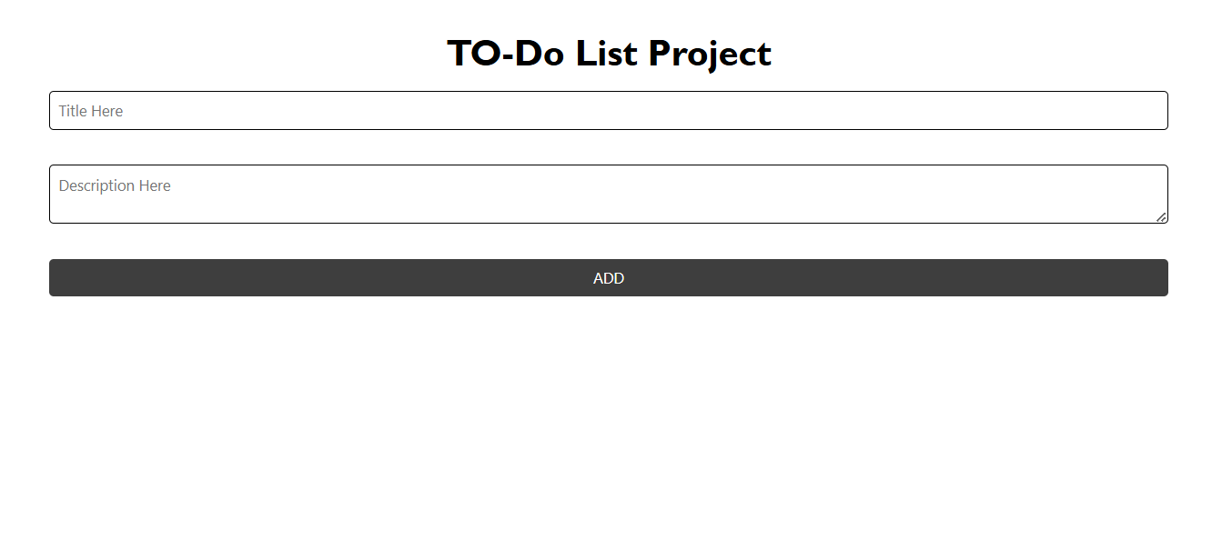
Project 1: To-Do List Application (Easy)
Objective:
To create a fully functional web-based To-Do List using HTML, CSS and JavaScript.
Key Features:
Add your daily goals to track the completed goals or tasks and uncompleted tasks for increasing the efficiency of work and time management.

Slide 5
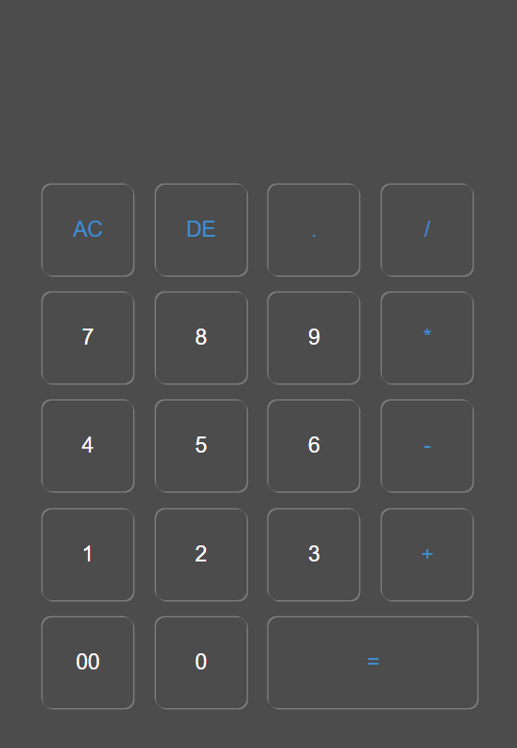
Project 2: Calculator Website (Intermediate)
Objective:
To perform basic arithmetic operation using web-based Calculator.
Key Features:
The Calculator Application project aimed to create an interface for performing basic arithmetic operations. I utilized JavaScript for functionality and ensured a responsive design using CSS.

Slide 6
Conclusion and Future Goals
In conclusion, my internship with MLSA has been a transformative experience.
Enhancing my technical skills and preparing me for future challenges.
I aim to further explore advanced web technologies and contribute to impactful projects in the field of web development.

Slide 7
Thank You !

